Slide 1


Python QML Arduino GUI Practical Training Handout
Written by :
Muhammad Husni Muttaqin, S. Pd
Diky Zakaria, M. T.
PROGRAM STUDI MEKATRONIKA DAN KECERDASAN BUATAN
UPI KAMPUS DAERAH PURWAKARTA
AGUSTUS 2022

Slide 2

About me
Name : Muhammad Husni Muttaqin, S. Pd.
Birth date : 5 June 1998
Hometown : Bandung
Current Job : python programmer at PT Syergie Indoprima and part time teacher
Experiences :
- 2019 - 2020 : Dynamics Positioning System engineer on cable ship (PT Syergie Indoprima)
- 2021 - 2022 : Electronics and control system engineer for Vent-I (PT Syergie Automa Teknologi)
- 2022 – now : Python Programmer PT Syergie Indoprima

Slide 3
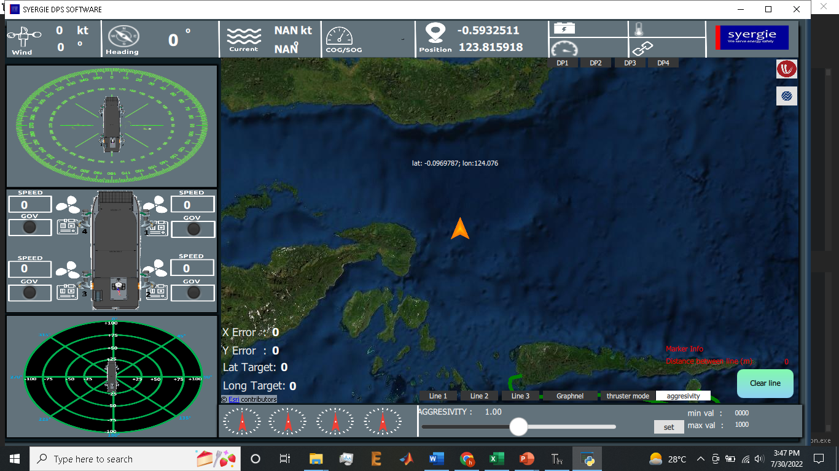
My experiences using python QML
1. Software Dynamic Positioning System

Slide 4
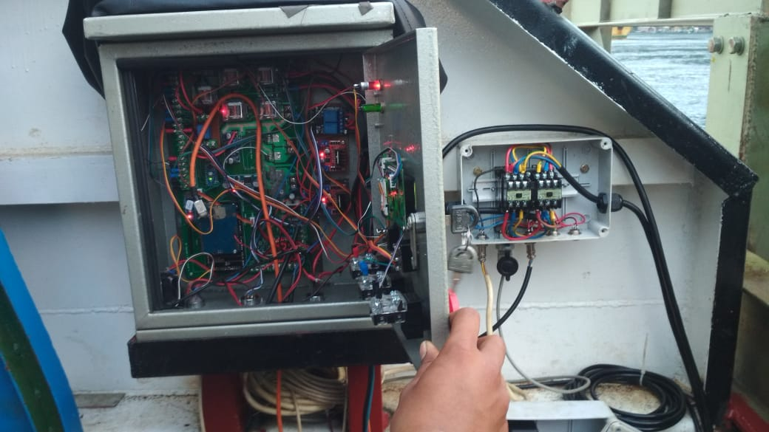

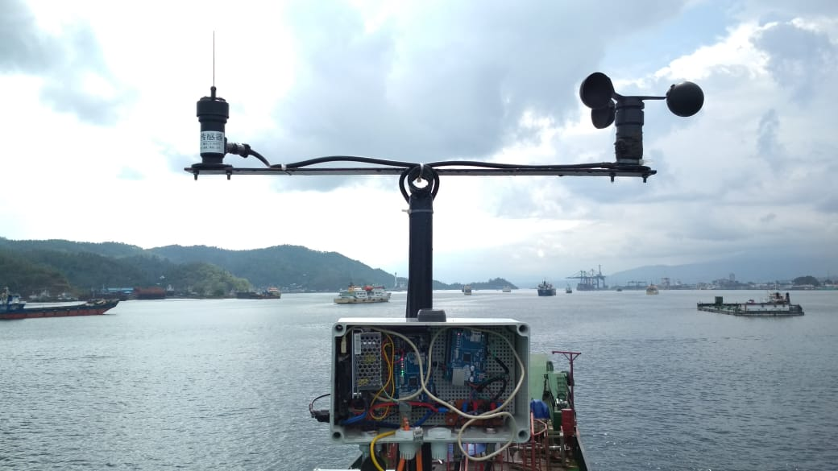
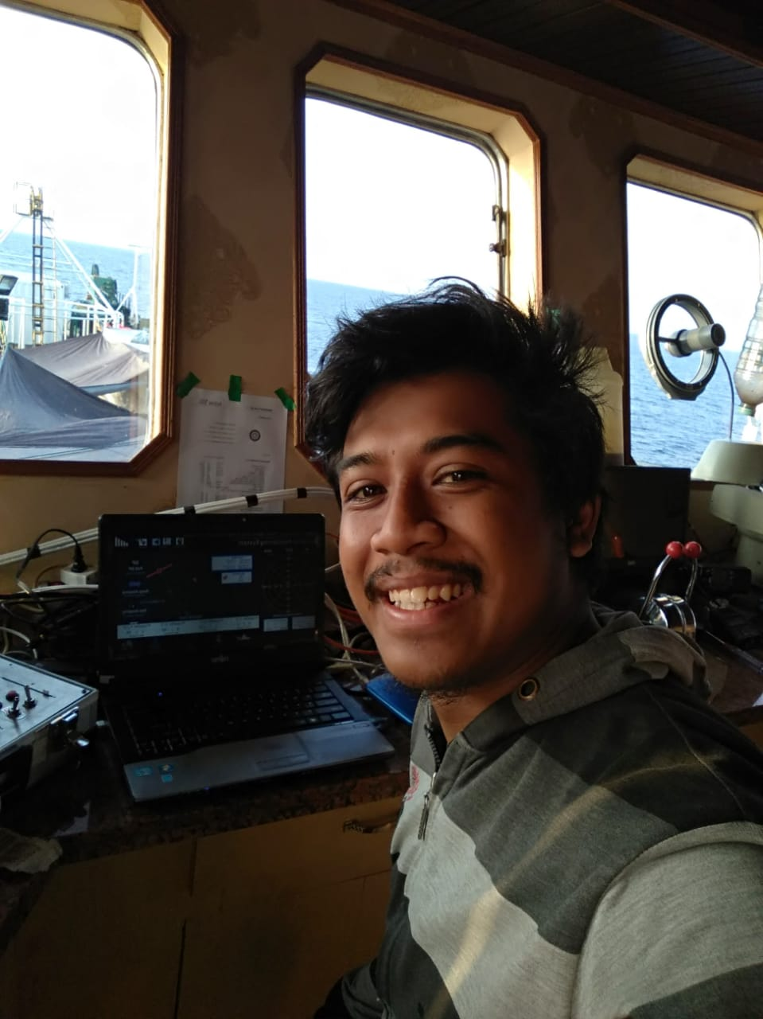
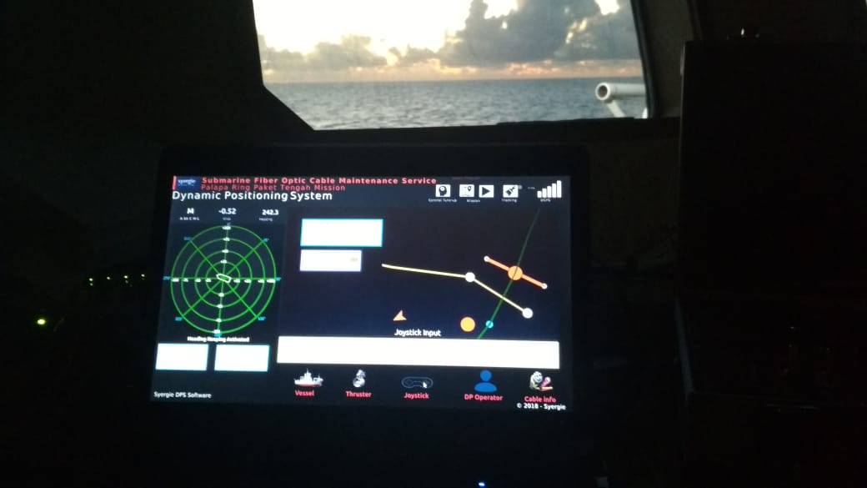

Slide 5
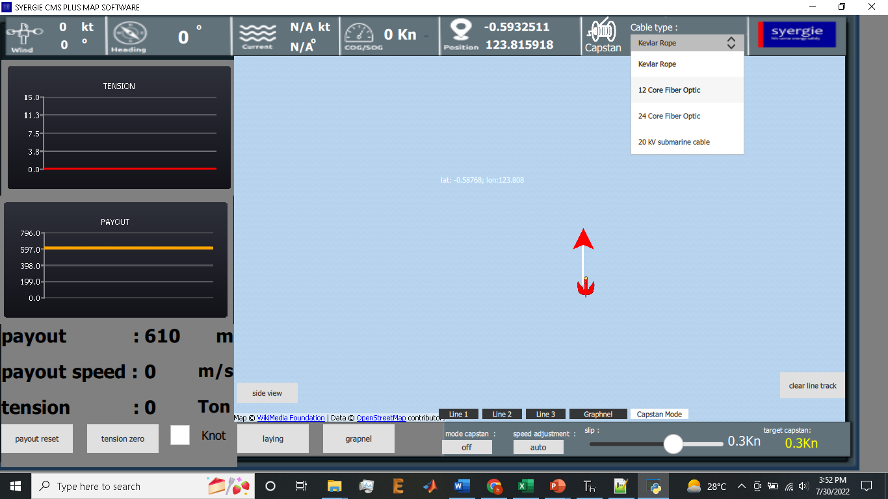
My experiences using python QML
2. Software Cable Management System

Slide 6
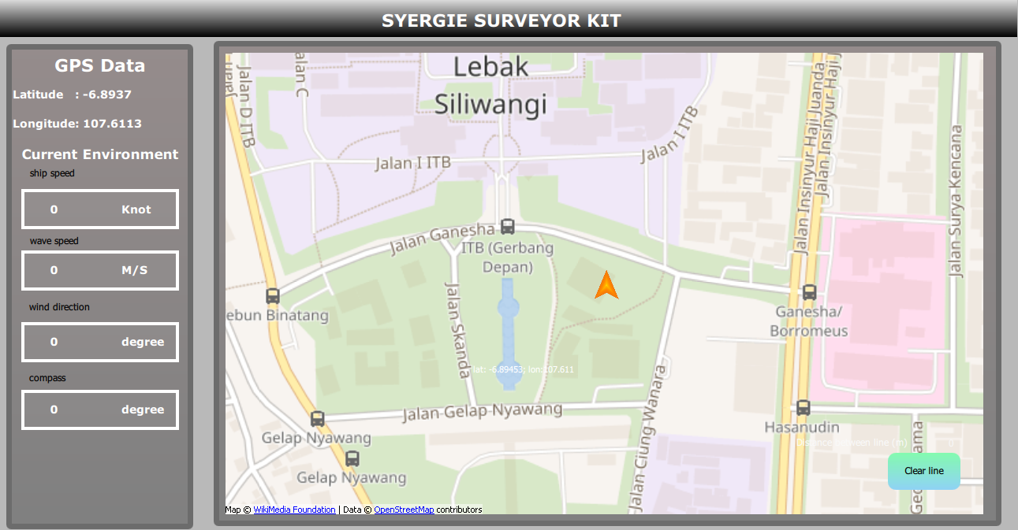
My experiences using python QML
3. Software Survey Arus bawah laut

Slide 7
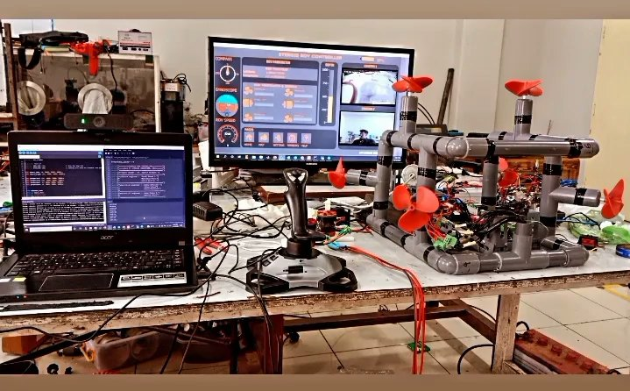
My experiences using python QML
4. Software kendali Underwater ROV

Slide 8
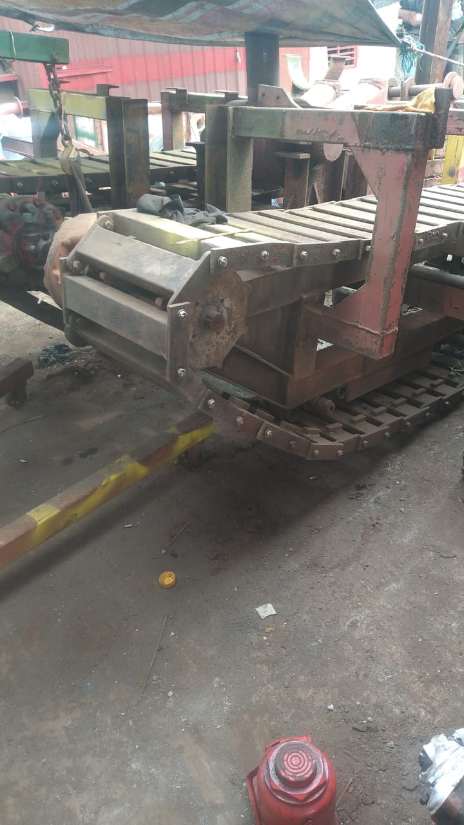

Slide 9
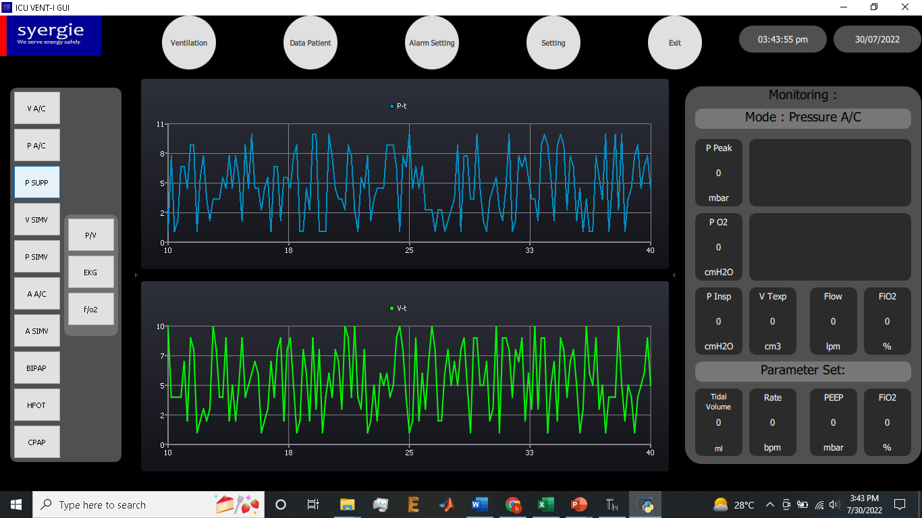
My experiences using python QML
5. ICU Ventilator GUI

Slide 10
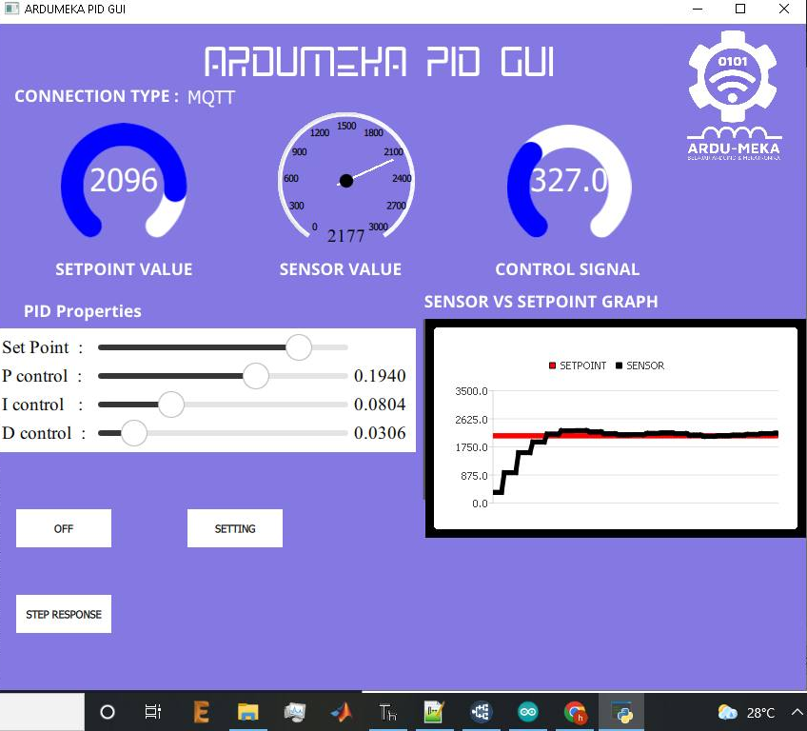
My experiences using python QML
6. Ardumeka PID GUI

Slide 11
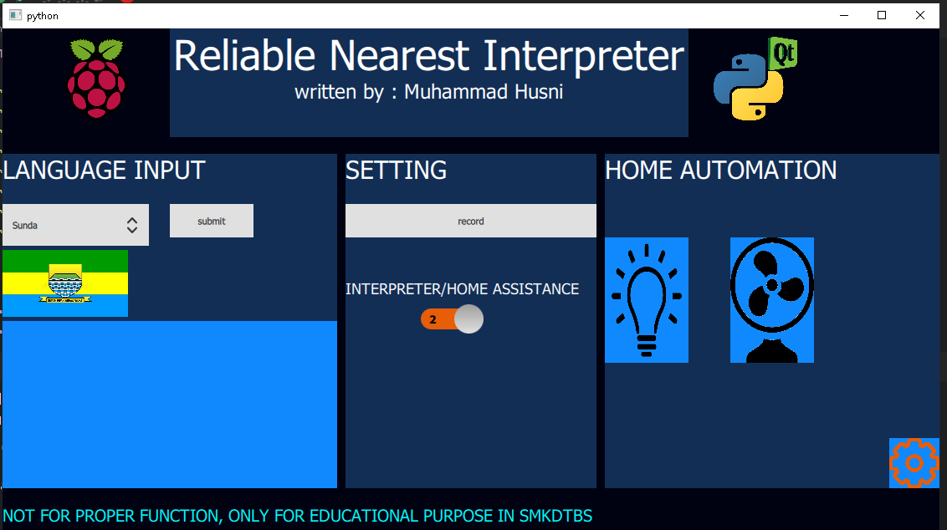
My experiences using python QML
7. On progress : ReNI (Reliable Nearest Interpreter)

Slide 12
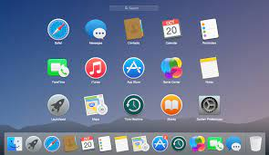
What is GUI ?

Slide 13
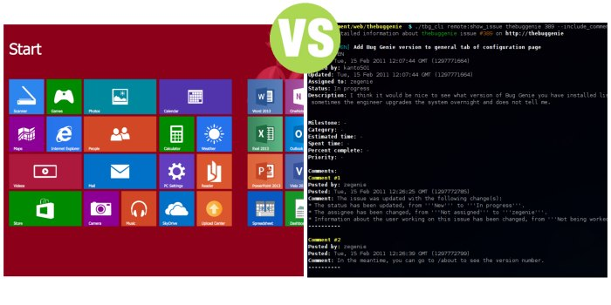
GUI vs CLI

Slide 14
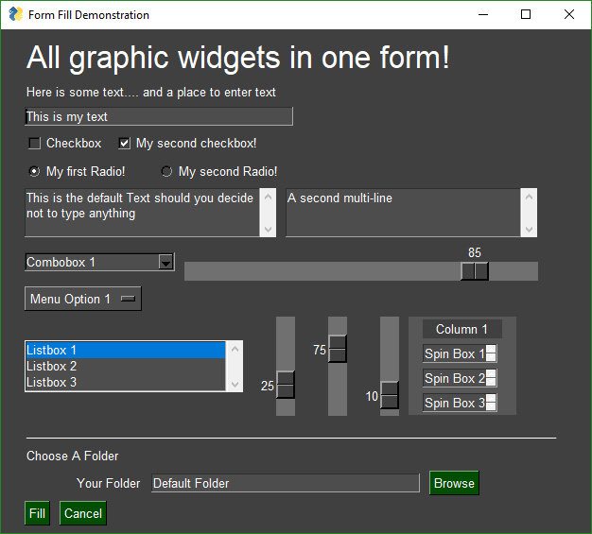
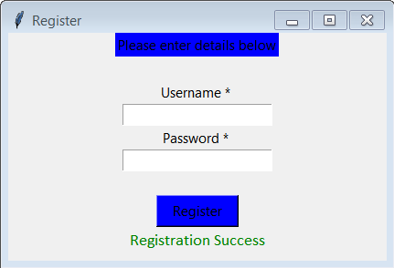
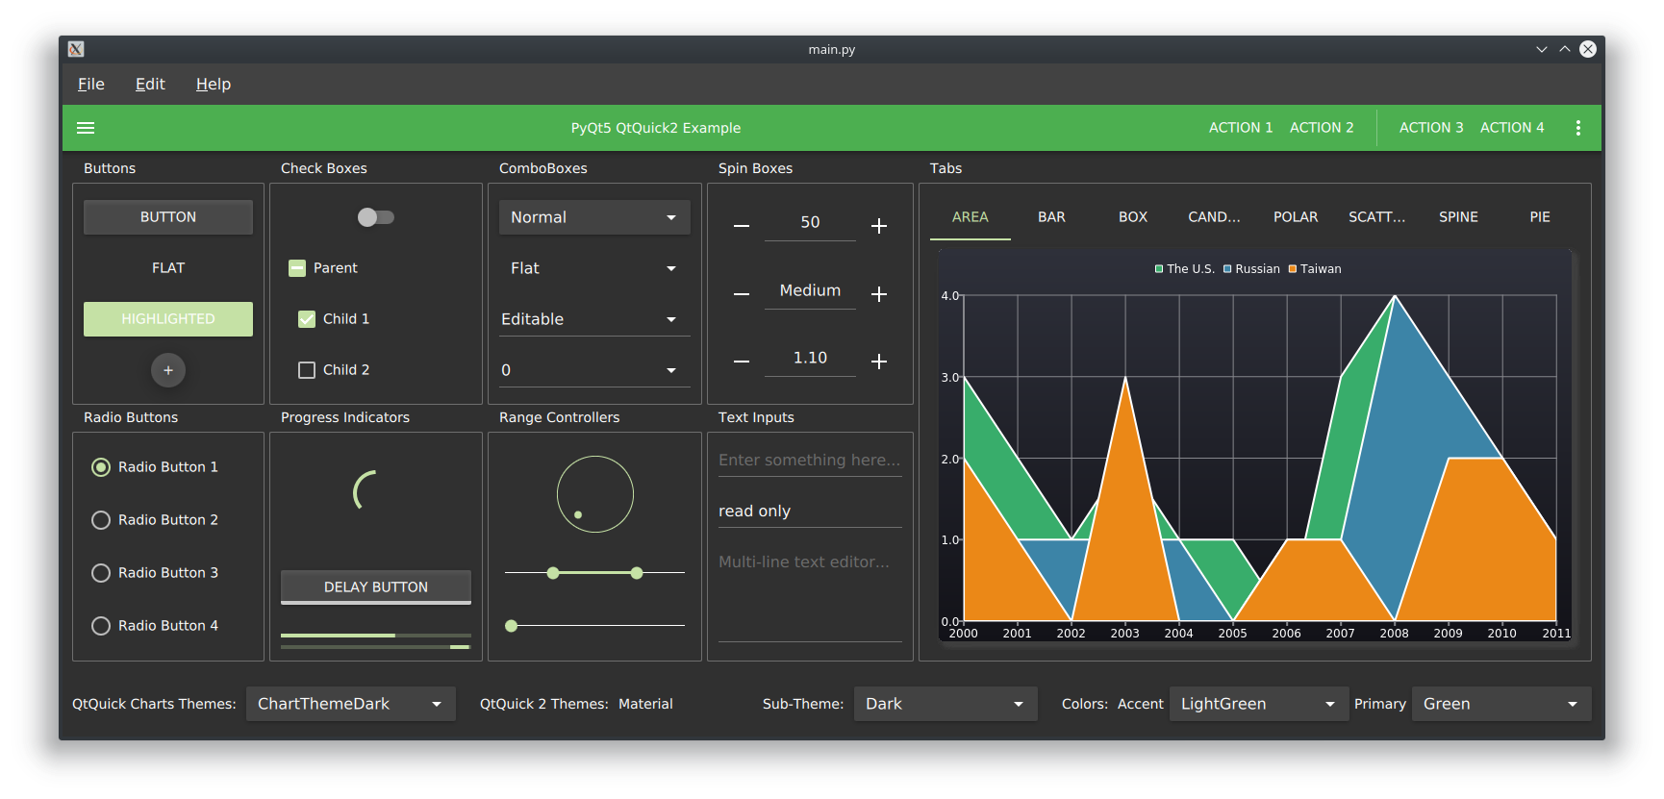
Python GUI
Tkinter
PySimpleGUI
PyQt QML

Slide 15
timeline
75 minutes practice
30 minutes QnA and debug
15 minutes preparation
Total : 120 Minutes

Slide 16
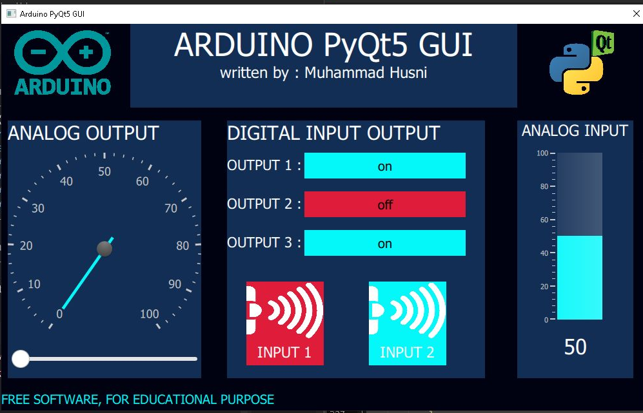
Today Workshop Project with PyQt5

Slide 17
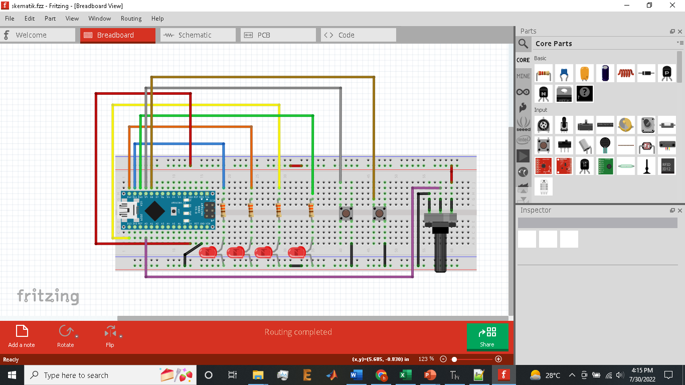
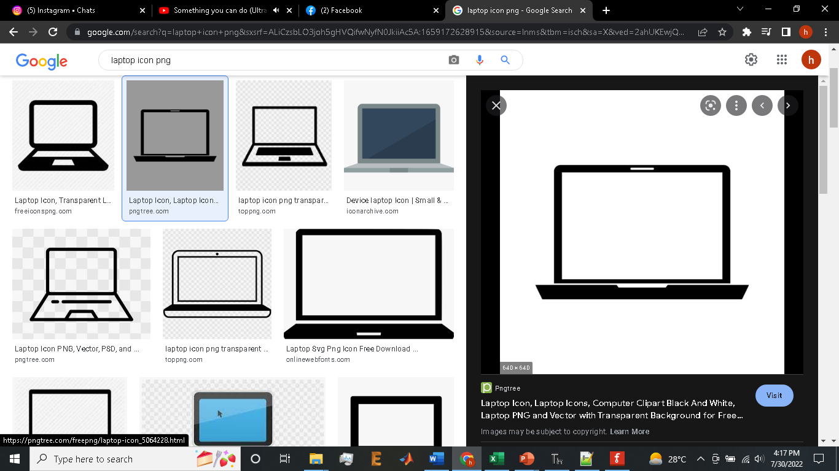

Slide 18
Preparation
Software Installation
Notepad++
Thonny IDE
- PyQt5 Library
Arduino IDE
CH340 Driver

Slide 19
Hardware Wiring

Slide 20
RUN EXAMPLE CODE FIRST TO MAKE SURE PREPARATION DONE PERFECTLY ☺

Slide 21
HOW PyQt5 WORK
1
1 add windows
2 add text
3 Add button
4 Add slider
5 Add image
6 Add gauge and circular gauge
7 Integrate python and qml
8 Serial data parsing
5
2
3
6
6
4

Slide 22
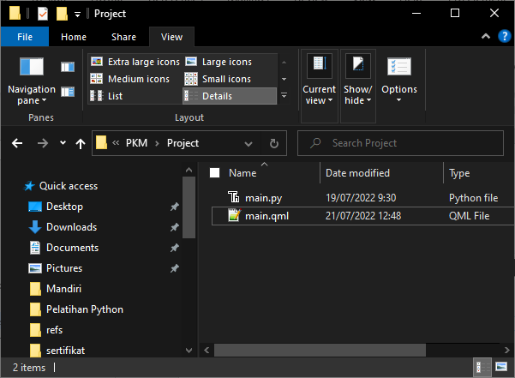
Create new folder
.py
.qml

Slide 23
Python base code
from PyQt5.QtCore import *
from PyQt5.QtGui import *
from PyQt5.QtQml import *
from PyQt5.QtWidgets import *
from PyQt5.QtQuick import *
import sys
class table(QObject):
def __init__(self, parent = None):
super().__init__(parent)
self.app = QApplication(sys.argv)
self.engine = QQmlApplicationEngine(self)
self.engine.rootContext().setContextProperty("backend", self)
self.engine.load(QUrl("main.qml"))
if __name__ == "__main__":
main = table()

Slide 24
Qml base code
import QtQuick 2.12
import QtQuick.Window 2.13
import QtQuick.Controls 2.0
import QtQuick.Controls.Styles 1.4
import QtQuick.Extras 1.4
import QtQuick.Extras.Private 1.0
Window {
id : root
width: 400
height: 400
title:"membuat windows"
color : "pink"
visible: true
//flags: Qt.WindowMaximized //Qt.Dialog
}

Slide 25
Experiment
Make your windows with your favorite color ☺

Slide 26
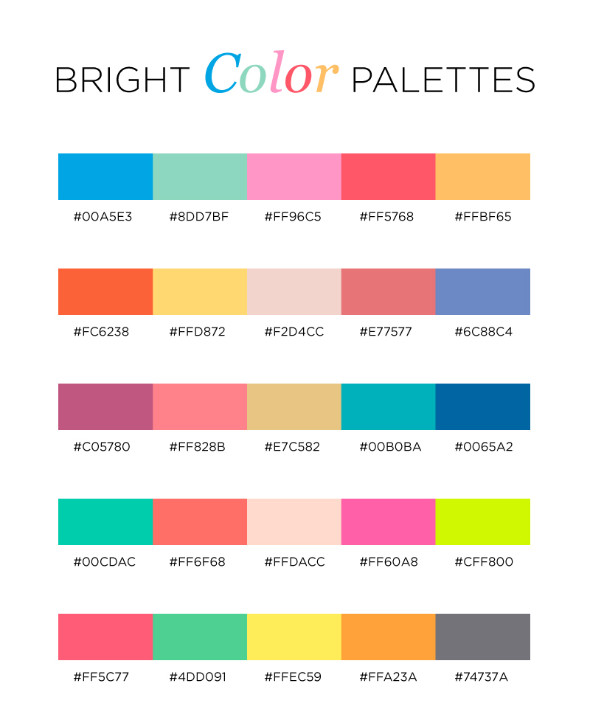
Little tricks => color pallete
color : “#FF96C5"

Slide 27
Add some text on your window
Text{
id : text1
x:100
y:200
text:"Hello World"
color: "#00FF00"
font.family : "Comic Sans MS"
font.pixelSize: 35
font.bold : true
}
WRITE YOUR NAME ON YOUR WINDOW

Slide 28
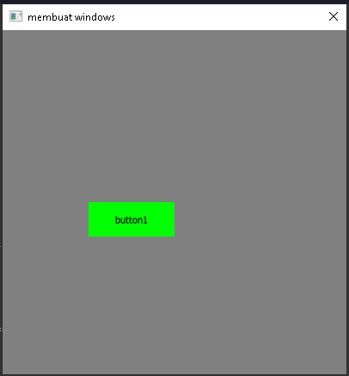
Add some buttons on your window
Button {
id: button1
x :100
y :200
text: "button1"
palette {
button: "#00FF00"
buttonText: "black"
}
onClicked:{
}
}
MAKE THREE BUTTONS

Slide 29
Little tricks => toggle button
Button {
id: button3
x :120
y :170
width : 250
text: "off"
font.pixelSize : 20
onClicked:{
if(button3.text == "on"){
text = "off";
button3_color.color = "#df1c39"
}else
if(button3.text == "off"){
text = "on";
button3_color.color = "#04f8fa"
}
}
}

Slide 30
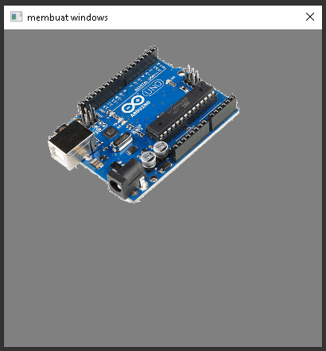
Add some picture on your window
Image{
x:50
y:0
width : 250
height : 250
source: "arduino.png"
}

Slide 31
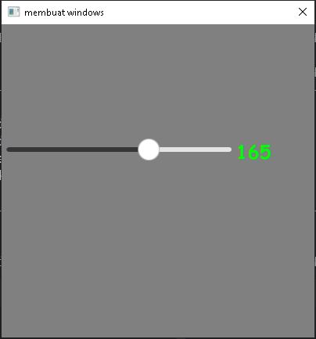
Add slider on your window
Slider {
id: slider1
x:0
y:150
height: 20
width: 300
value: 0
from:10
to: 255
stepSize: 5
orientation: Qt.Horizontal
onValueChanged: {
}
}

Slide 32
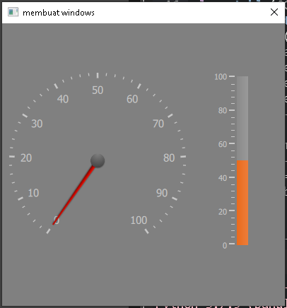
Add gauge on your window
Gauge {
id : gauge2
x: 300
y: 70
height : 250
width : 250
minimumValue: 0
value: 50
maximumValue: 100
tickmarkStepSize: 20
style: GaugeStyle {
valueBar: Rectangle {
color: "#e85d08"
implicitWidth: 16
}
}
}

Slide 33
Add circular gauge on your window
CircularGauge {
id : gauge1
x: 10
y: 70
height : 250
width : 250
value: 0
minimumValue: 0
maximumValue: 100
style: CircularGaugeStyle {
labelStepSize: 10
}
}

Slide 34
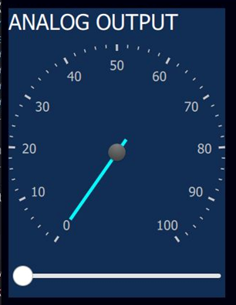
Little tricks => grouping using Rectangle
Rectangle{
x: 200
y:0
width : 600
height : 130
color : "#122e55“
//insert your QML Component inside here ☺
}

Slide 35
Integrate python with qml
Python <= QML
class table(QObject):
def __init__(self, parent = None):
super().__init__(parent)
self.app = QApplication(sys.argv)
self.engine = QQmlApplicationEngine(self)
self.engine.rootContext().setContextProperty("backend", self)
self.engine.load(QUrl("main.qml"))
##############TOMBOL QML KE PYTHON ##########
@pyqtSlot(str)
def button1(self, message):
print(message)
##########SLIDER QML KE PYTHON###################
@pyqtSlot(str)
def analog_output(self, message):
print(message)
Button {
…….
onClicked:{
backend.button1(“clicked")
}
}
Slider {
…….
onValueChanged:{
backend.button1(“clicked")
}
}

Slide 36
Integrate python with qml
Python => QML
Timer{
id:transferdata
interval: 50
repeat: true
running: true
onTriggered: {
pot_val.text = backend.get_analog()
}
}
##########KIRIM DATA ANALOG KE GAUGE##############
@pyqtSlot(result=float)
def get_analog(self): return analog

Slide 37
Python to Arduino Data Parsing
Preparations :
Make sure the wiring was correct
Make sure the COM was detected, if not you must install CH340 driver
- Upload “FIRMWARE.INO” to your Arduino
- Test by using the my example code

Slide 38
Port scan python
print ("select your arduino port:")
def serial_ports():
if sys.platform.startswith('win'):
ports = ['COM%s' % (i + 1) for i in range(256)]
elif sys.platform.startswith('linux') or sys.platform.startswith('cygwin'):
# this excludes your current terminal "/dev/tty"
ports = glob.glob('/dev/tty[A-Za-z]*')
elif sys.platform.startswith('darwin'):
ports = glob.glob('/dev/tty.*')
else:
raise EnvironmentError('Unsupported platform')
result = []
for port in ports:
try:
s = serial.Serial(port)
s.close()
result.append(port)
except (OSError, serial.SerialException):
pass
return result
print(str(serial_ports()))
port = input("write port : ")
ser = serial.Serial(port, 9600, timeout=3)

Slide 39
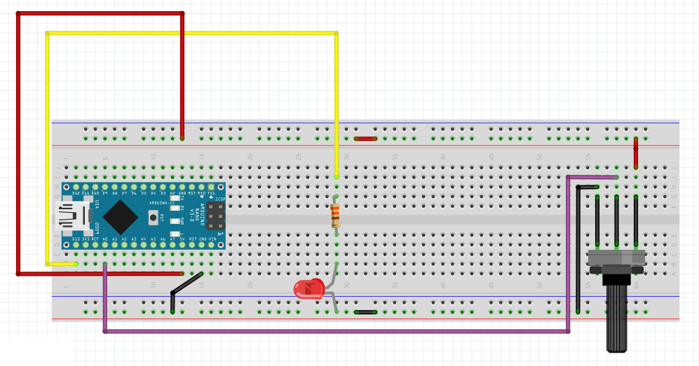
Basic serial communication
H : led on
L : led off
0-1023

Slide 40
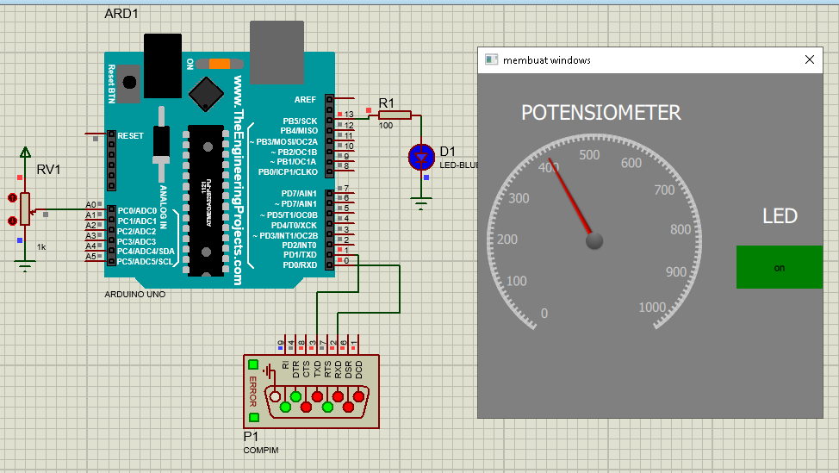
Basic serial communication

Slide 41
Python to Arduino Data Parsing
Python to Arduino
* (val 1) | (val 2) | (val 3) | (val 4)
Arduino to Python
(val 1) : (val 2) : (val 3)

Slide 42
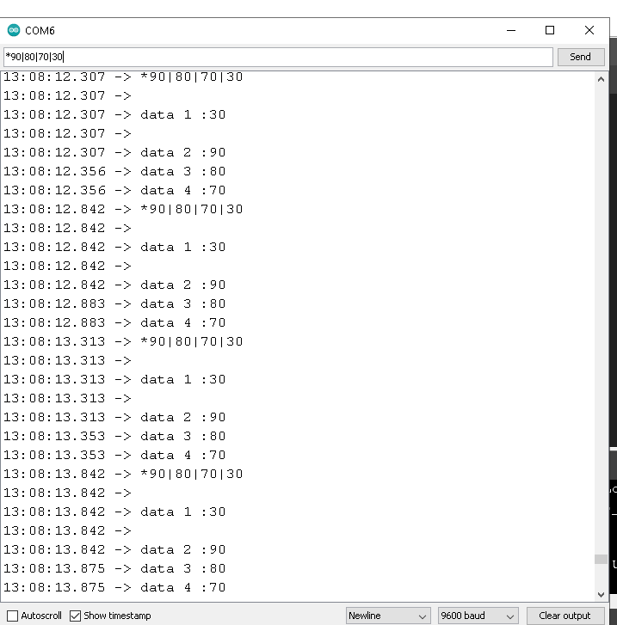
How it works ?

Slide 43
def serial_write(num):
global transmit_time
global transmit_time_prev
global data_send
while True:
transmit_time = time.time() - transmit_time_prev
data_send = (str("*") + str(button1_status) + str("|")
+ str(button2_status) + str("|")
+ str(button3_status) + str("|")
+ str(analog_output) +str("|")
)
if (transmit_time > 0.5):
print(data_send)
ser.write(data_send.encode())
transmit_time_prev = time.time()
while (Serial.available()>0){
delay(10);
c = Serial.read();
myString += c;
data_buffer = myString;
}
if (myString.length()>0){
Index1 = myString.indexOf('*');
Index2 = myString.indexOf('|', Index1+1);
Index3 = myString.indexOf('|', Index2+1);
Index4 = myString.indexOf('|', Index3+1);
Index5 = myString.indexOf('|', Index4+1);
secondValue = myString.substring(Index1+1, Index2);
thirdValue = myString.substring(Index2+1, Index3);
fourthValue = myString.substring(Index3+1, Index4);
firstValue = myString.substring(Index4+1, Index5);
myString="";
}
led1_status = fourthValue.toInt();
led2_status = thirdValue.toInt();
led3_status = secondValue.toInt();
led_pwm_val = firstValue.toInt();
digitalWrite(led1, led1_status);
digitalWrite(led2, led2_status);
digitalWrite(led3, led3_status);
analogWrite(led_pwm, led_pwm_val);

Slide 44
def serial_read(num):
global ser_bytes
global decoded_bytes
global serial_data
global analog
global data
global input1_color
global input2_color
while True:
try:
ser_bytes = ser.readline()
serial_data = (ser_bytes.decode('utf-8')[:-2])
#print(serial_data)
except:
serial_data = serial_data
data = serial_data.split(":")
analog = int(data[0])
if (data[1] == "0"):
input1_color = "#df1c39"
else:
input1_color = "#04f8fa"
if (data[2] == "0"):
input2_color = "#df1c39"
else:
input2_color = "#04f8fa"
time_send = millis() - prev_time_send;
if (time_send > 500){
Serial.print(analogRead(pot));
Serial.print(":");
Serial.print(!digitalRead(button1));
Serial.print(":");
Serial.print(!digitalRead(button2));
Serial.println("");
prev_time_send = millis();
}

Slide 45
Let’s see the result ☺

Slide 46
Thanks for your participation, I hope this means more for all of you ☺

Slide 47
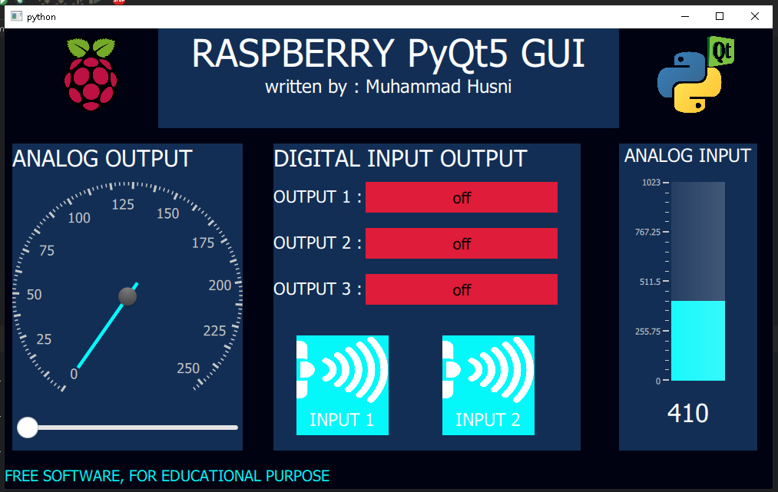

Slide 48
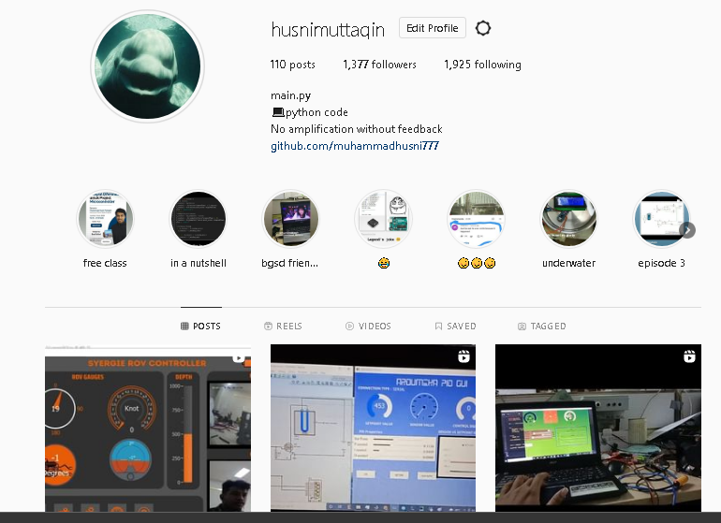
My Instagram

Slide 49
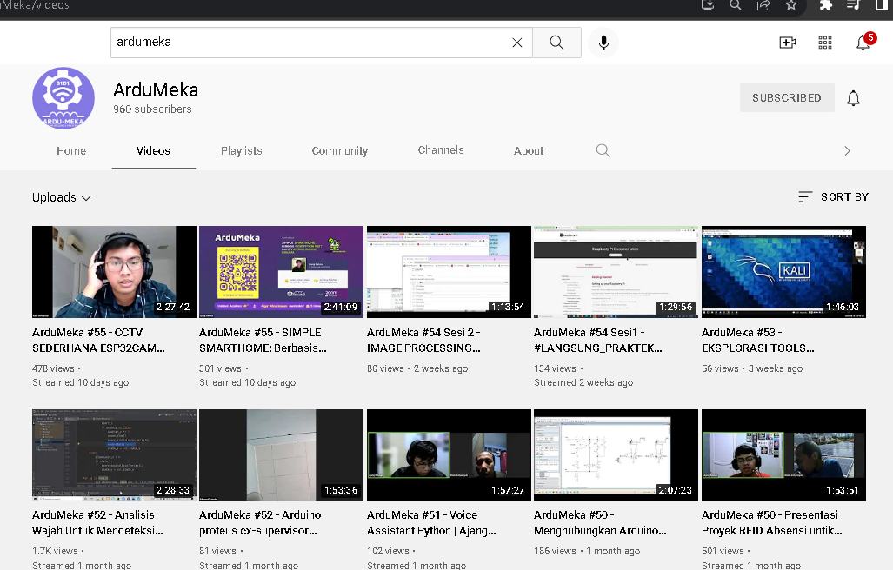
SUPPORT US

